Slide 1


Social Buzz Report

Slide 2


Today's agenda
Project recap
Problem
The Analytics team
Process
Insights
Summary

Slide 3


Social Buzz, a rapidly expanding tech giant,
has to adjust swiftly to its worldwide reach.
Accenture has started a three-month trial
project that aims to:
An audit of Social Buzz's big data practice.
Suggest how Social Buzz can launch a profitable IPO.
Finding the five most popular categories of content
on Social Buzz by analyzing the data.
Project Recap

Slide 4


Problem
Every day, more than 100,000 posts are created
That’s over 36.5 million pieces of content in a year!
But how can you capitalize the most of this abundance?
Analyze the data to discover the top 5 categories of content that Social Buzz users love

Slide 5



Andrew Fleming
Chief Technical Architect
The Analytics team
Marcus Rompton
Senior Principle
Koushal Kumar
Data Analyst

Slide 6

Process
1
Data Understanding
2
Data Cleaning
3
Data Modelling
4
Data Analysis
5
Uncover Insights

Slide 7
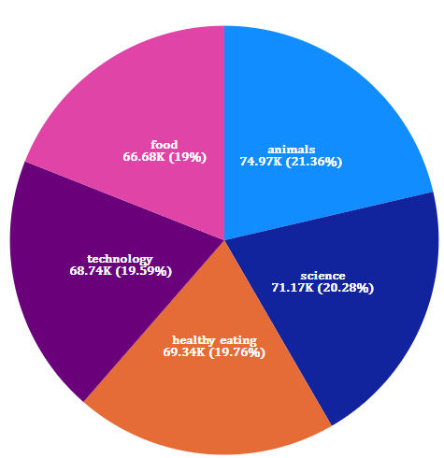


Insights
These are the top 5 most popular content categories as per
the chart. The average score per category is 70,177.20.
The Highest revenue category is Animals, with a total score of 74,965. This means that content related to animals, such as videos, photos, GIF, or audio, is the most popular and Engaging among the audience.
The difference between the Animals and Food categories is 8,289.00. This means that there is a significant gap in the demand and value of different types of content.

Slide 8
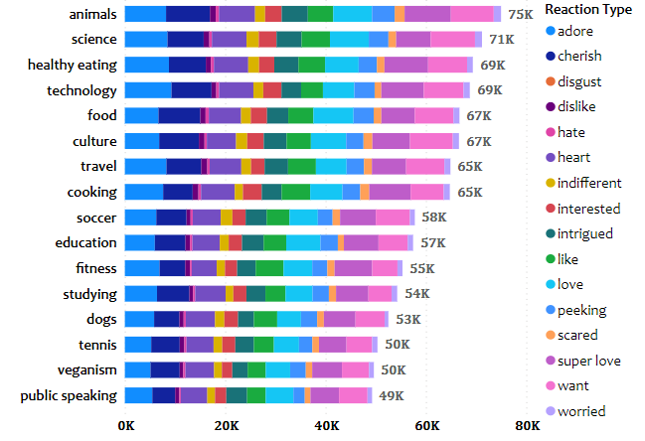
Insights
There are total 16 type of Content Categories and each having scores based on the type of reaction from audience.
Animals type category is the most popular
one with having 15 out of 16 unique
reactions (except disgust)

Slide 9
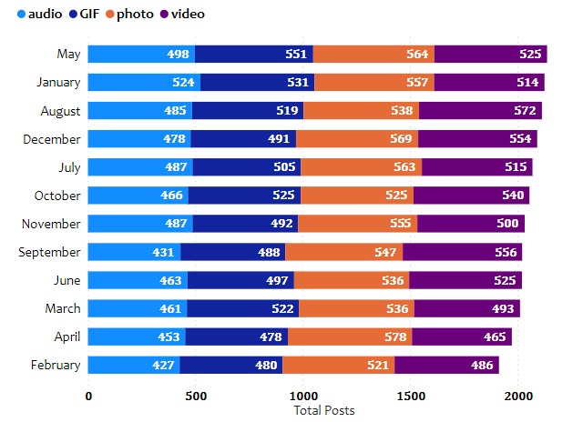
Insights
We observed that May had the most number of posts among all the months.
Video posts are more comparison to the
other types where as Audio is the least
preferred post.
.

Slide 10


Summary
Content related to animals is the most popular and engaging among the audience, with the highest score and the most positive reactions, while content related to public speaking is the least popular and engaging, with the lowest score and the least positive reactions.
The demand and value of different types of content vary significantly, with a large gap between the highest and lowest scoring categories. Video posts are more preferred than other formats, while audio posts are the least preferred. May was the month with the most number of posts.

Slide 11

Thank you!
ANY QUESTIONS?

